Slide 1
Fox+ and ASCENT
2022 Hamvention

Slide 2
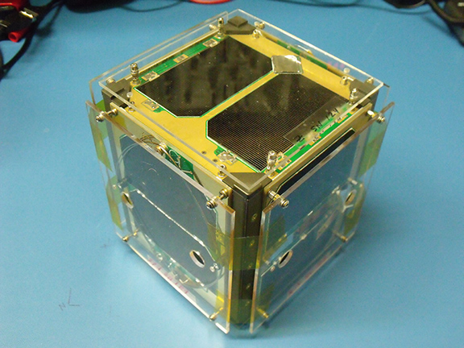
Fox+
Vision
Building on Fox
LEO
1U+ → Increasing Size
FM+ → Increasing Capability
Open Source and Open Access
Early Work
Systems Engineering
RF
Structure
Shared with Golf
Power System
RF

Slide 3
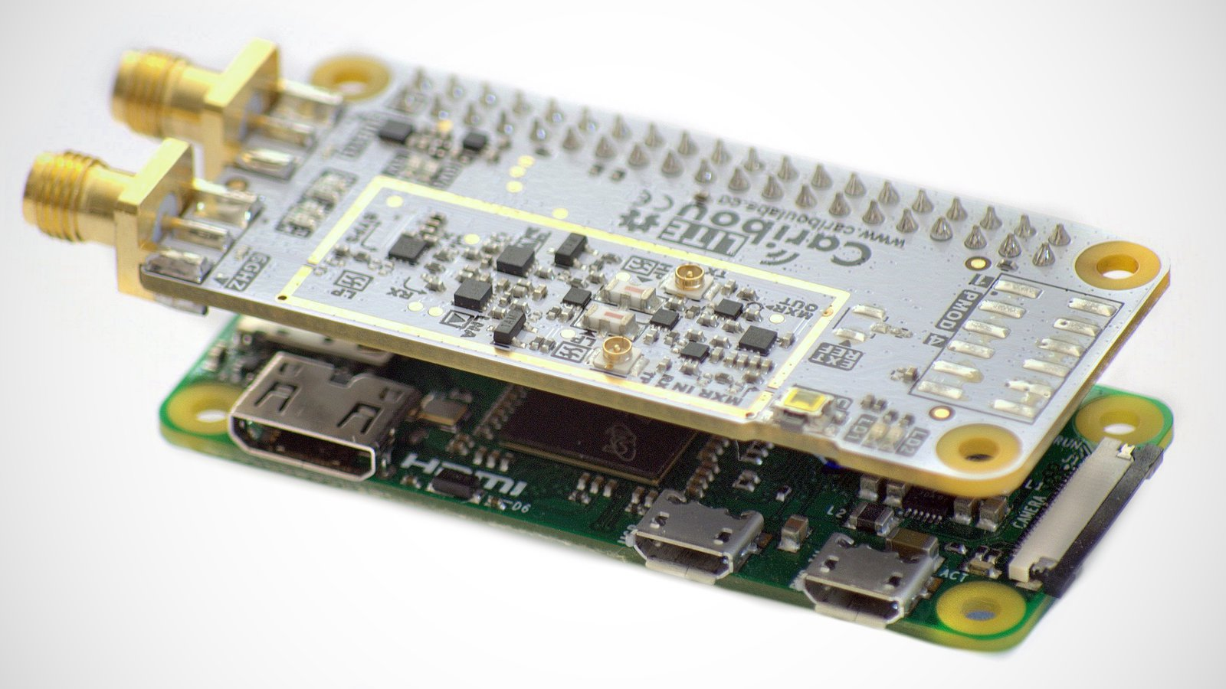
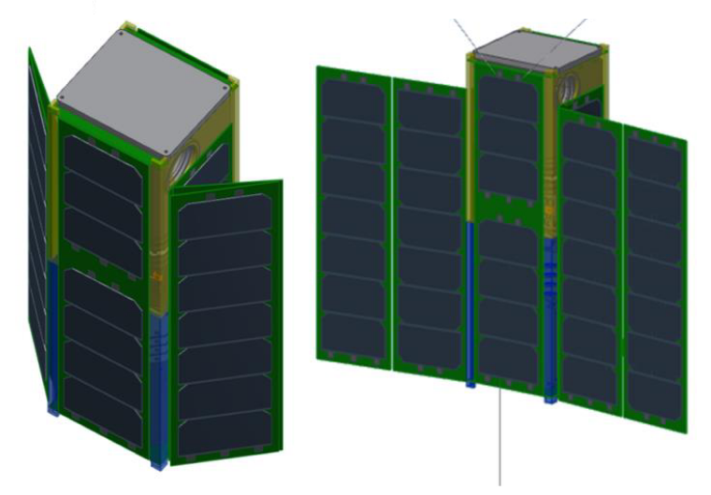
https://www.crowdsupply.com/cariboulabs/cariboulite-rpi-hat

Slide 4
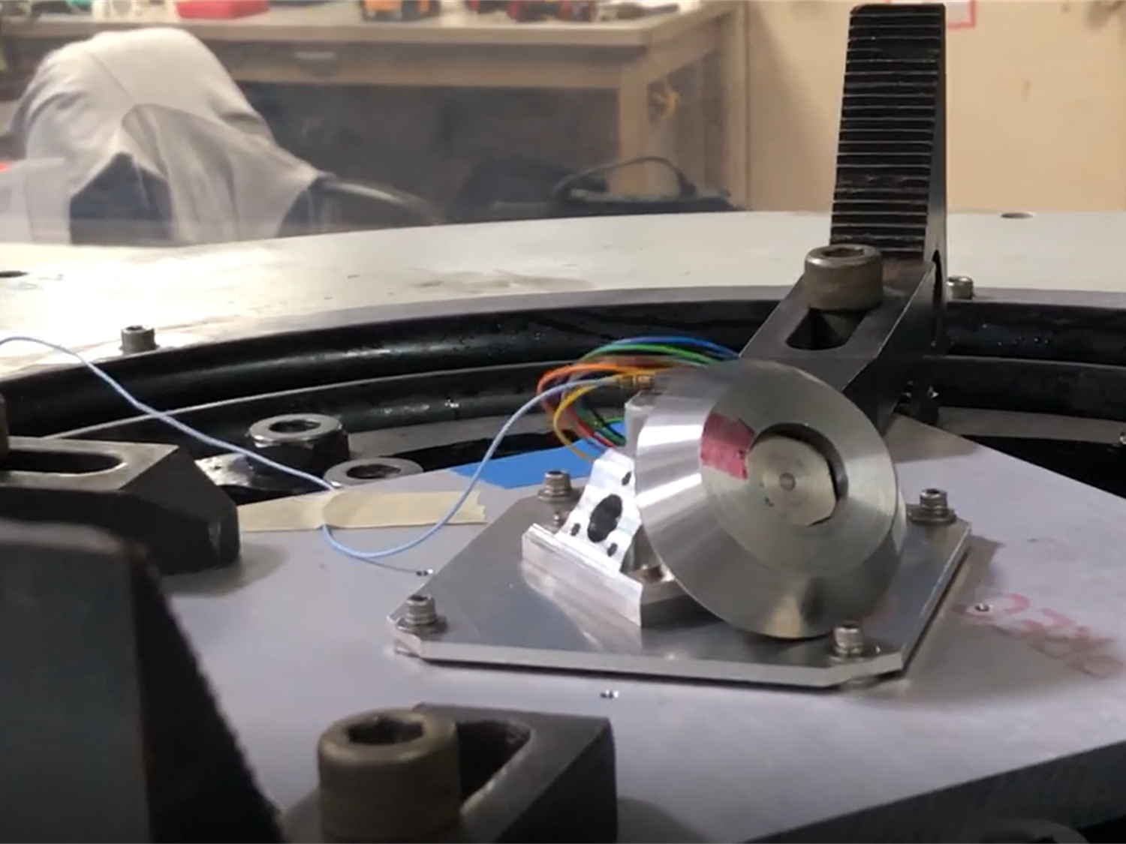
ASCENT
Reaction Wheels
Engineering
Vibration Test
Deployable Solar Panels
ARDC Grant
Open Source and Open Access

Slide 5
Engineering Volunteers
Mechanical Engineering
RF Engineering
Flight Software Engineering
Stop by the Booth

